Slide 1
Municipal Solid Waste
Jennifer Naples
Environmental Science

Slide 2
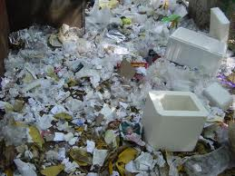
What is MSW?
Waste that is produced in________,________ ,_________,_______________and other places in the ________________.
MSW is not produced by construction, agriculture or __________________

Slide 3
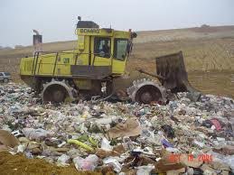
Handling Solid Waste
How do we handle our solid waste?
________ it
________ it
________ it

Slide 4
Burying Waste
Sanitary Landfills
Designed to prevent leachate from seeping out and running off into _________ and __________
Holds waste safely
Keeps water from getting _________________

Slide 5
Sanitary Landfill

Slide 6
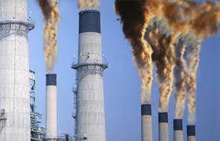
Burning Waste
Burning solid waste is called ______________
Can be used to generate _________________
Release some ___________
Some waste still _________

Slide 7
Recycling
Reclaiming _____ materials and reusing them
______________________ resources
Saves ___________________
Reduces _____________________ damage

Slide 8
Recycling

Slide 9
Recycling
There are 4 types of products that can be recycled
Metals can be ________________ and reused
Glass can be melted down to make _______ glass containers
Paper products can be recycled _______________
______________ types of plastics can be recycled

Slide 10
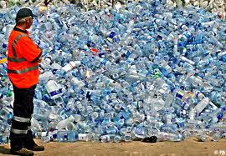
Recycling
Mountains of Water Bottles

Slide 11
The Down Side of Recycling
Recycling is not the complete answer to the large amount of waste that we create
Some materials_____ _____ be recycled
Some recycled products have _________ uses
Uses ________________
Creates pollution

Slide 12
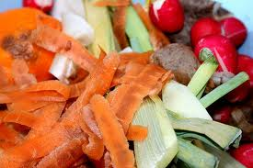
Biodegradable Products
When something can be broken down and recycled ____________ it is considered biodegradable.
__________________ are biodegradable

Slide 13
The Three R’s
Controlling solid waste includes the three R’s
________ – create less waste in the first place
__________ – find another use for something
_______ – Reclaiming raw materials to create something new

Slide 14
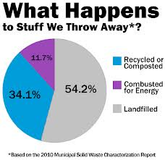
Reduce, Reuse, Recycle

Slide 15
Composting
A process of helping the NATURAL _____________________ process break down many forms of waste
Excellent form of __________________
Can be done on a _________ or _________ scale

Slide 16
Composting
The elements of composting

